Slide 1
4. 2D Shapes / Image

Slide 2
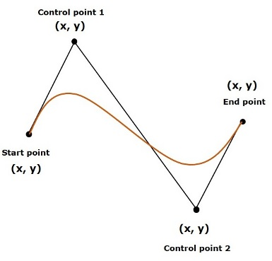
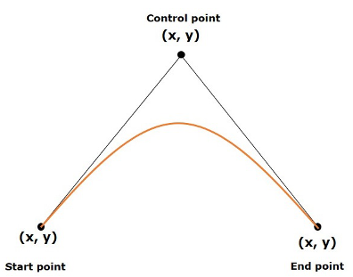
2D Shapes
Line
Rectangle
Rounded Rectangle
Circle
Ellipse
Polygon : closed shape
Polyline : not closed shape
Cubic Curve : Bezier parametric curve (degree 3)
QuadCurve : Bezier parametric curve (degree 2)
Arc

Slide 3
2D Shape 생성단계(예)
Shape 클래스의 객체 생성
Line line = new Line();
Shape 객체의 Property 설정
line.setStartX(150);
line.setStartY(140);
line.setEndX(450);
line.setEndY(140);
Shape 객체를 Group에 추가
Group root = new Group();
root.getChildren().add(line);
Parent
Group
Region
Pane

Slide 4
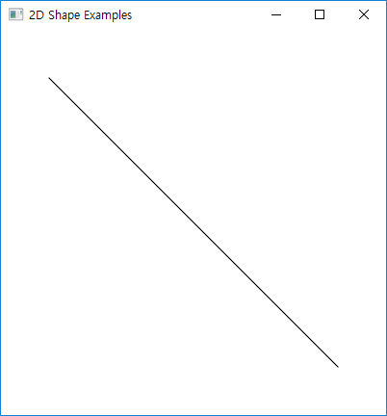
Line
Properties
startX, startY, endX, endY
public void start(Stage primaryStage) throws Exception
{
Group root = new Group();
Line line = new Line();
line.setStartX(50.0);
line.setStartY(50.0);
line.setEndX(350.0);
line.setEndY(350.0);
root.getChildren().add(line);
Scene scene = new Scene(root,400,400);
primaryStage.setTitle("2D Shape Examples");
primaryStage.setScene(scene);
primaryStage.show();
}

Slide 5
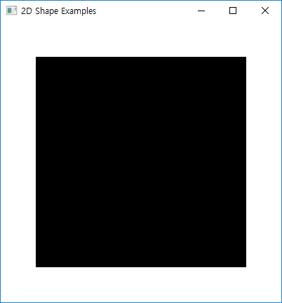
Rectangle / Rounded Rectangle
Properties
X, Y, Width, Height, arcWidth, arcHeight
public void start(Stage primaryStage) throws Exception
{
Group root = new Group();
Rectangle rect = new Rectangle();
rect.setX(50.0f);
rect.setY(50.0f);
rect.setWidth(300.0f);
rect.setHeight(300.0f);
root.getChildren().add(rect);
Scene scene = new Scene(root,400,400);
primaryStage.setTitle("2D Shape Examples");
primaryStage.setScene(scene);
primaryStage.show();
}

Slide 6
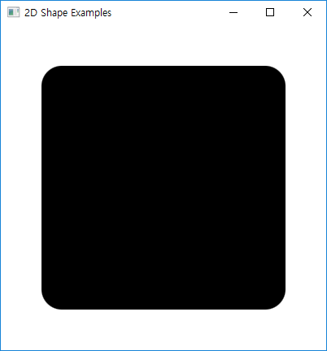
public void start(Stage primaryStage) throws Exception
{
Group root = new Group();
Rectangle rect = new Rectangle();
rect.setX(50.0f);
rect.setY(50.0f);
rect.setWidth(300.0f);
rect.setHeight(300.0f);
rect.setArcWidth(50.0);
rect.setArcHeight(50.0);
root.getChildren().add(rect);
Scene scene = new Scene(root,400,400);
primaryStage.setTitle("2D Shape Examples");
primaryStage.setScene(scene);
primaryStage.show();
}

Slide 7
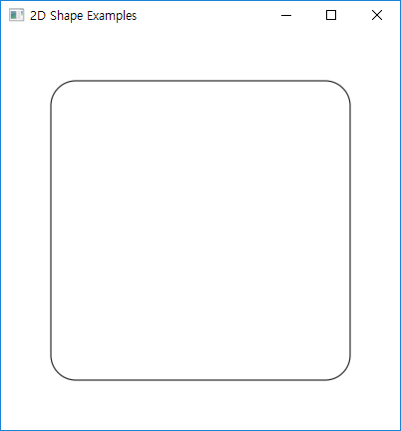
public void start(Stage primaryStage) throws Exception
{
Group root = new Group();
Rectangle rect = new Rectangle();
rect.setX(50.0f);
rect.setY(50.0f);
rect.setWidth(300.0f);
rect.setHeight(300.0f);
rect.setArcWidth(50.0);
rect.setArcHeight(50.0);
rect.setFill(null);
rect.setStroke(Color.BLACK);
root.getChildren().add(rect);
Scene scene = new Scene(root,400,400);
primaryStage.setTitle("2D Shape Examples");
primaryStage.setScene(scene);
primaryStage.show();
}

Slide 8
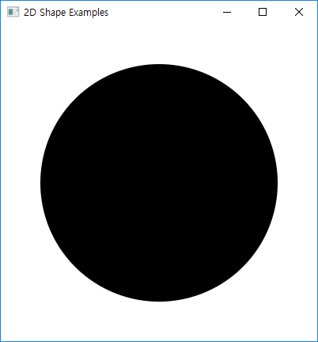
Circle
Properties
centerX, centerY, radius
public void start(Stage primaryStage) throws Exception
{
Group root = new Group();
Circle circle = new Circle();
circle.setCenterX(200);
circle.setCenterY(200);
circle.setRadius(150);
root.getChildren().add(circle);
Scene scene = new Scene(root,400,400);
primaryStage.setTitle("2D Shape Examples");
primaryStage.setScene(scene);
primaryStage.show();
}

Slide 9
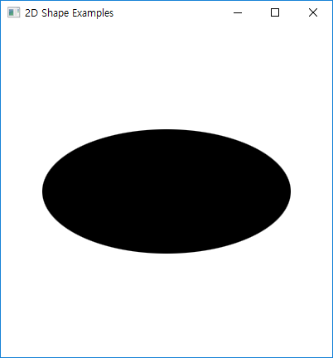
Ellipse
Properties
centerX, centerY, radius, radiusY
public void start(Stage primaryStage) throws Exception
{
Group root = new Group();
Ellipse ellipse = new Ellipse();
ellipse.setCenterX(200.0f);
ellipse.setCenterY(200.0f);
ellipse.setRadiusX(150.0f);
ellipse.setRadiusY(75.0f);
root.getChildren().add(ellipse);
Scene scene = new Scene(root,400,400);
primaryStage.setTitle("2D Shape Examples");
primaryStage.setScene(scene);
primaryStage.show();
}

Slide 10
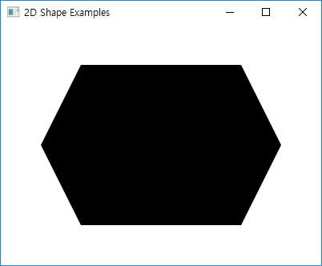
Polygon
참고 : polygon.getPoints().addAll(new Double[] { ... });
public void start(Stage primaryStage) throws Exception {
Group root = new Group();
double[] points = new double[] {
100.0, 50.0,
300.0, 50.0,
350.0, 150.0,
300.0, 250.0,
100.0, 250.0,
50.0, 150.0
};
Polygon hexagon = new Polygon(points);
root.getChildren().add(hexagon);
Scene scene = new Scene(root,400,300);
primaryStage.setTitle("2D Shape Examples");
primaryStage.setScene(scene);
primaryStage.show();
}

Slide 11
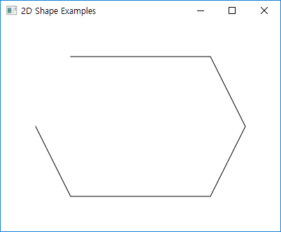
Polyline
참고 : polyline.getPoints().addAll(new Double[] { ... });
public void start(Stage primaryStage) throws Exception {
Group root = new Group();
double[] points = new double[] {
100.0, 50.0,
300.0, 50.0,
350.0, 150.0,
300.0, 250.0,
100.0, 250.0,
50.0, 150.0
};
Polyline polyline = new Polyline(points);
root.getChildren().add(polyline);
Scene scene = new Scene(root,400,300);
primaryStage.setTitle("2D Shape Examples");
primaryStage.setScene(scene);
primaryStage.show();
}

Slide 12
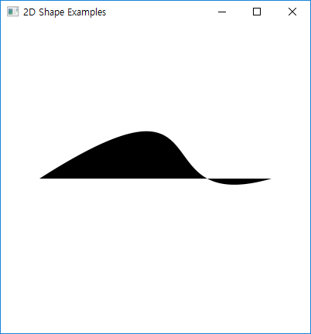
CubicCurve
Properties
startX, startY, controlX1, controlY1, controlX2, controlY2, endX, endY
public void start(Stage primaryStage) throws Exception {
Group root = new Group();
CubicCurve cubicCurve = new CubicCurve();
cubicCurve.setStartX(50.0f);
cubicCurve.setStartY(200.0f);
cubicCurve.setControlX1(300.0f);
cubicCurve.setControlY1(40.0f);
cubicCurve.setControlX2(175.0f);
cubicCurve.setControlY2(250.0f);
cubicCurve.setEndX(350.0f);
cubicCurve.setEndY(200.0f);
root.getChildren().add(cubicCurve);
Scene scene = new Scene(root,400,400);
primaryStage.setTitle("2D Shape Examples");
primaryStage.setScene(scene);
primaryStage.show();
}

Slide 13
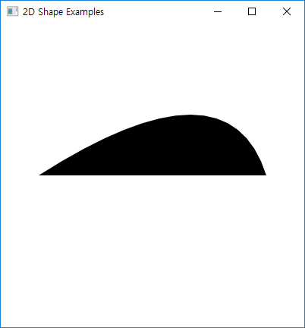
QuadCurve
Properties
startX, startY, controlX, controlY, endX, endY
public void start(Stage primaryStage) throws Exception {
Group root = new Group();
QuadCurve quadCurve = new QuadCurve();
quadCurve.setStartX(50.0f);
quadCurve.setStartY(200.0f);
quadCurve.setControlX(300.0f);
quadCurve.setControlY(40.0f);
quadCurve.setEndX(350.0f);
quadCurve.setEndY(200.0f);
root.getChildren().add(quadCurve);
Scene scene = new Scene(root,400,400);
primaryStage.setTitle("2D Shape Examples");
primaryStage.setScene(scene);
primaryStage.show();
}

Slide 14
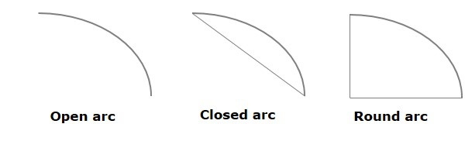
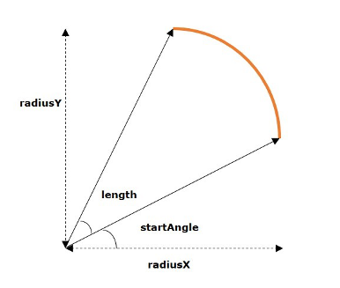
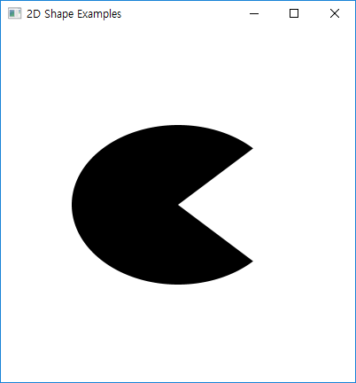
Arc
Properties
startAngle, length, centerX, center, radiusX, radius
ArcType : OPEN, CHORD, ROUND
public void start(Stage primaryStage) throws Exception {
Group root = new Group();
Arc arc = new Arc();
arc.setCenterX(200.0f);
arc.setCenterY(200.0f);
arc.setRadiusX(120.0f);
arc.setRadiusY(90.0f);
arc.setStartAngle(45.0f);
arc.setLength(270.0f);
arc.setType(ArcType.ROUND);
root.getChildren().add(arc);
Scene scene = new Scene(root,400,400);
primaryStage.setTitle("2D Shape Examples");
primaryStage.setScene(scene);
primaryStage.show();
}

Slide 15
Transformations
어떤 그래픽에 대한 다양한 변환을 지원
Translation, Scaling Up or Down, Rotation, Shearing 등
주요 클래스
Rotate
Scale
Translate
Shear

Slide 16
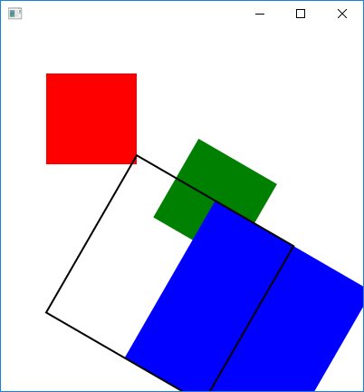
public void start(Stage primaryStage) throws Exception {
AnchorPane root = new AnchorPane();
Rectangle rect1 = new Rectangle(50, 50, 100, 100);
rect1.setFill(Color.RED);
Rectangle rect2 = new Rectangle(50, 50, 100, 100);
rect2.setFill(Color.GREEN);
Rectangle rect3 = new Rectangle(50, 50, 100, 100);
rect3.setFill(Color.BLUE);
Rectangle rect4 = new Rectangle(50, 50, 100, 100);
rect4.setFill(null); rect4.setStroke(Color.BLACK);
Rotate rotate = new Rotate();
rotate.setAngle(30);
rotate.setPivotX(0);
rotate.setPivotY(400);
Scale scale = new Scale();
scale.setX(2.0);
scale.setY(2.0);
//scale.setPivotX(75);
//scale.setPivotY(75);
Translate translate = new Translate();
translate.setX(-50);
translate.setY(0);
translate.setZ(0);
rect2.getTransforms().addAll(rotate);
rect3.getTransforms().addAll(rotate, scale);
rect4.getTransforms().addAll(rotate, scale, translate);
root.getChildren().addAll(rect1, rect2, rect3, rect4);
Scene scene = new Scene(root,400,400);
primaryStage.setScene(scene);
primaryStage.show();
}

Slide 17
Text
Package
javafx.scene.text
javafx.scene.shape을 상속
주요 메소드
setX, setY
setText, getText
setFont
text.setFont(Font.font("verdana",
FontWeight.BOLD, FontPosture.REGULAR, 20));
setFill, setStroke, setStrokeWidth
setStrikethrough
setUnderline

Slide 18
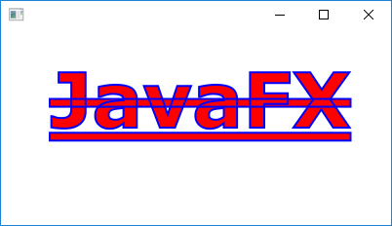
public void start(Stage primaryStage) throws Exception {
AnchorPane root = new AnchorPane();
Text text = new Text();
text.setText("JavaFX");
text.setX(50);
text.setY(100);
text.setFont(Font.font("verdana",
FontWeight.BOLD, FontPosture.REGULAR, 78));
text.setFill(Color.RED);
text.setStroke(Color.BLUE);
text.setStrokeWidth(2);
text.setStrikethrough(true);
text.setUnderline(true);
root.getChildren().add(text);
Scene scene = new Scene(root,400,200);
primaryStage.setScene(scene);
primaryStage.show();
}

Slide 19
Image
javafx.scene.image
지원포맷 : bmp, gif, png, jpg
주요 메소드
setX, setY, setFitWidth, setFitHeight
setPreserveRatio
Image Loading
//Passing FileInputStream object as a parameter
FileInputStream inputstream = new FileInputStream("image.jpg");
Image image = new Image(inputstream);
// Loading image from URL
// Image image = new Image(new FileInputStream("url"));
ImageView imageView = new ImageView(image);

Slide 20
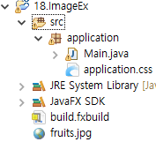
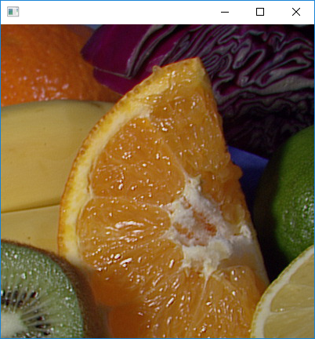
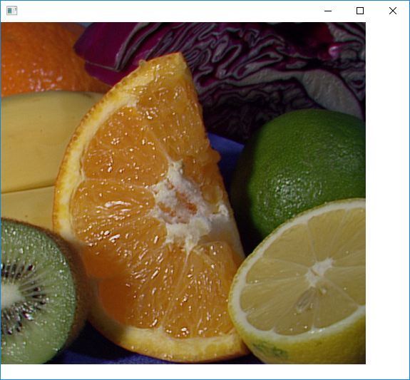
public void start(Stage primaryStage) throws Exception
{
AnchorPane root = new AnchorPane();
Image image = new Image(new FileInputStream(".\\fruits.jpg"));
double width = image.getWidth();
double height = image.getHeight();
ImageView imageView = new ImageView(image);
imageView.setX(0);
imageView.setY(0);
imageView.setFitWidth(width);
imageView.setFitHeight(height);
imageView.setPreserveRatio(true);
root.getChildren().add(imageView);
Scene scene = new Scene(root,400,400);
primaryStage.setScene(scene);
primaryStage.show();
}

Slide 21
Canvas Graphic

Slide 22
Canvas 컨트롤의 사용
JavaFX의 Graphic
Canvas & GraphicsContext를 사용
GraphicsContext
AWT/Swing의 Graphics 클래스와 유사
Group root = new Group();
Canvas canvas = new Canvas(300, 200);
GraphicsContext gc = canvas.getGraphicsContext2D();
draw(gc);
root.getChildren().add(canvas);
public void draw(GraphicsContext gc)
{
// drawShapes with gc
}

Slide 23
GraphicsContext
선 그리기
strokeLine(double x1, double y1, double x2, double y2)
원 그리기
strokeOval(double x, double y, double w, double h)
fillOval(double x, double y, double w, double h)
사각형 그리기
strokeRect(double x, double y, double w, double h)
fillRect(double x, double y, double w, double h)
strokeRoundRect(double x, double y, double w, double h, double arcWidth, double arcHeight)
fillRoundRect(double x, double y, double w, double h, double arcWidth, double arcHeight)

Slide 24
호 그리기
strokeArc(double x, double y, double w, double h, double startAngle, double arcExtent, ArcType closure)
fillArc(double x, double y, double w, double h, double startAngle, double arcExtent, ArcType closure)
텍스트 그리기
strokeText(String text, double x, double y)
fillText(String text, double x, double y)
이미지 그리기
drawImage(Image img, double x, double y)
drawImage(Image img, x, y, w, h)
drawImage(Image img, sx, sy, sw, sh, dx, dy, dw, dh)

Slide 25
import javafx.application.Application;
import javafx.stage.Stage;
import javafx.scene.Scene;
import javafx.scene.canvas.Canvas;
import javafx.scene.canvas.GraphicsContext;
import javafx.scene.layout.Pane;
import javafx.scene.paint.Color;
import javafx.scene.shape.ArcType;
public void start(Stage primaryStage)
{
Canvas canvas = new Canvas(400, 200);
GraphicsContext gc = canvas.getGraphicsContext2D();
draw(gc);
Pane root = new Pane();
root.getChildren().add(canvas);
Scene scene = new Scene(root);
primaryStage.setTitle("Canvas Example");
primaryStage.setScene(scene);
primaryStage.show();
}

Slide 26
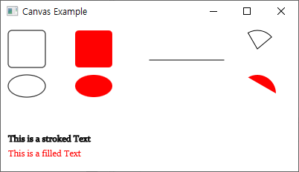
Draw Shapes
public void draw(GraphicsContext gc)
{
gc.setLineWidth(1.0);
gc.setFill(Color.RED);
gc.strokeRoundRect(10, 10, 50, 50, 10, 10);
gc.fillRoundRect(100, 10, 50, 50, 10, 10);
gc.strokeOval(10, 70, 50, 30);
gc.fillOval(100, 70, 50, 30);
gc.strokeLine(200, 50, 300, 50);
gc.strokeArc(320, 10, 50, 50, 40, 80, ArcType.ROUND);
gc.fillArc(320, 70, 50, 50, 0, 120, ArcType.OPEN);
gc.strokeText("This is a stroked Text", 10, 160);
gc.fillText("This is a filled Text", 10, 180);
}

Slide 27
자주 사용되는 import문
import javafx.application.*;
import javafx.stage.*;
import javafx.scene.*;
import javafx.scene.layout.*;
import javafx.scene.input.*;
import javafx.scene.image.*;
import javafx.scene.media.*;
import javafx.scene.paint.*;
import javafx.scene.shape.*;
import javafx.scene.text.*;
import javafx.scene.control.Alert.*;
import javafx.scene.control.cell.*;
import javafx.scene.effect.*;
import javafx.scene.transform.*;
import javafx.scene.chart.*;
import javafx.event.*;
import javafx.collections.*;
import javafx.geometry.*;
import javafx.beans.binding.*;
import javafx.beans.property.*;
import javafx.beans.value.*;
[유용한 단축키]
- eclipse
1. 자동 import
Ctrl + Shift + M
2. 한꺼번에 이름 고치기
Alt + Shift + R
3. 인텔리센스
Ctrl + Space

